Slide 1
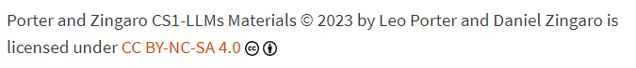
CSE 8A – Introduction to Programming and Computational Problem Solving I
Game Design – A Big Example
Part 2
How to get help:
Class Website
https://sites.google.com/ucsd.edu/cse8afa23/home
Piazza for brief questions or logistic questions
Tutor Hours for help with homework/setting up computer To get help, use Autograder (directions on piazza)
Office Hours for homework/conceptual help
Slides based, in part, on materials from Dan Zingaro.
Notes:
Welcome!

Slide 2
Announcements
Grades Posted on canvas (including participation!)
Please review piazza post and check your grades
If correction needed, make a private post on piazza
Quiz 4 – 12/6 (Week 10)
Code writing only. Guide released.
Must be able to log into lab machines
Questions will be on coding related to images
Project 3 on games!
Checkpoint due tomorrow night (just need a game in mind and how you’ll represent it in code)
Final exam in ~2 weeks
Will be a multi-part exam with some using Copilot
Similarly, must be able to use the lab machines
Also be sure you have Copilot setup on your personal machine and that you can sign into GitHub.

Slide 3
Learning Goals for Today
By the end of today’s lecture, you should be able to:
Determine the design of a game including the appropriate data structures to represent the state of the game
Author a game in Python with a playable user
Author a game simulation in Python

Slide 4
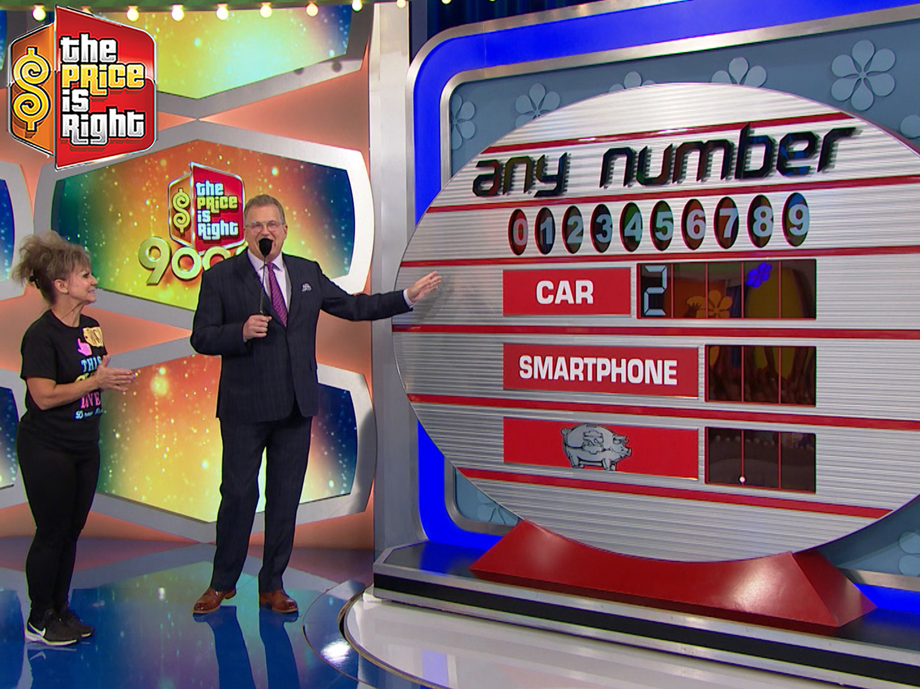
Reminder: The Game – “Any Number”!
Rules:
Each digit appears once on the board (except the first digit in the big prize in modern episodes)
The player receives the first prize that has all the numbers completed
Any Number from the Price is Right: credit Amazon
Notes:
Original game on the Price is Right!

Slide 5
Our Big Picture Goal
Write the code to create two things:
A playable game by the player
A game we can simulate running repeatedly to determine the likelihood of winning
Notes:
List of lists – separate solution and current board
List of lists with tuples
Single list, we manage the math behind the scenes
Pretend there’s a solution and we create it as we go along. Possibly harder to debug.
Dictionary idea from Dan
Check for duplicate guesses or silent fail?

Slide 6
Reminder: Copilot struggled with solution_setup
def solution_setup():
""" Create a list of lists to be returned. The first list
will contain 5 numbers, the second list will contain 3 numbers,
and the last list will contain 3 numbers. The first element of
the first list should be a number between 2-4 randomly. The
remaining 10 digits (the last 4 digits in the first list
and the 3 digits in the 2nd and 3rd list) should be unique random
numbers between 0-9.
"""
# Your code here
return [None, None, None]
return [[],[],[]]
return [[3, 1, 9, 5, 7], [2, 6, 0], [8, 4, 7]]
Notes:
First is obviously wrong, second is too. Third isn’t right either! The only duplicate allowed is with the first number. But 7 is a duplicate.

Slide 7
Reminder: solution_setup – A possible option?
What is wrong with this code?
Runs forever
Doesn’t set the first digit to a number between 2-4
Doesn’t ensure the 10 numbers are all unique
Doesn’t make a list of the right size (3 lists, first with 5 elements, next two with 3 elements)
Nothing, this is correct
first_list = [random.randint(2,4)]
second_list = []
third_list = []
for i in range(10):
if i < 4:
first_list.append(random.randint(0,9))
elif i < 7:
second_list.append(random.randint(0,9))
else:
third_list.append(random.randint(0,9))
return [first_list, second_list, third_list]
Notes:
No attempt to ensure all 10 numbers are unique, just plain wrong.

Slide 8
solution_setup – A possible option?
list_of_lists = []
list_of_lists.append([random.randint(2, 4)])
while len(list_of_lists[0]) < 5:
n = random.randint(0, 9)
if n not in list_of_lists[0]:
list_of_lists[0].append(n)
while len(list_of_lists) < 3:
list_of_lists.append([])
while len(list_of_lists[-1]) < 3:
n = random.randint(0, 9)
if n not in list_of_lists[-1]:
list_of_lists[-1].append(n)
return list_of_lists
What is wrong with this code?
Runs forever
Doesn’t set the first digit to a number between 2-4
Doesn’t ensure the 10 numbers are all unique
Doesn’t make a list of the right size (3 lists, first with 5 elements, next two with 3 elements)
Nothing, this is correct
Notes:
Only looks at the current list, so duplicates are possible across the lists. ☹

Slide 9
Walkthrough of this solution
list_of_lists = []
list_of_lists.append([random.randint(2, 4)])
while len(list_of_lists[0]) < 5:
n = random.randint(0, 9)
if n not in list_of_lists[0]:
list_of_lists[0].append(n)
while len(list_of_lists) < 3:
list_of_lists.append([])
while len(list_of_lists[-1]) < 3:
n = random.randint(0, 9)
if n not in list_of_lists[-1]:
list_of_lists[-1].append(n)
return list_of_lists
Notes:
Slide to walkthrough the code from the last slide. Show how it creates the right shaped lists, that may be hard for the students.

Slide 10
solution_setup – A possible option?
list1 = []
list2 = []
list3 = []
list1.append(random.randint(2,4))
while len(list1) < 5:
num = random.randint(0,9)
if num not in list1:
list1.append(num)
while len(list2) < 3:
num = random.randint(0,9)
if num not in list1 and num not in list2:
list2.append(num)
while len(list3) < 3:
num = random.randint(0,9)
if num not in list1 and num not in list2 and num not in list3:
list3.append(num)
return [list1,list2,list3]
What is wrong with this code?
Runs forever
Doesn’t set the first digit to a number between 2-4
Doesn’t ensure the 10 numbers are all unique
Doesn’t make a list of the right size (3 lists, first with 5 elements, next two with 3 elements)
Nothing, this is correct
Notes:
I was initially fooled by this one as it’s close to the idea I wanted to do for this. The issue is that it includes the first digit from list1 (the one between 2-4) which means it’s trying to fit in 10 numbers in 11 spots. So it just runs forever.
The fix is actually pretty clean: need to change list1 to list1[1::] in the conditions throughout (so not in list1[1::])

Slide 11
solution_setup – Walkthrough
list1 = []
list2 = []
list3 = []
list1.append(random.randint(2,4))
while len(list1) < 5:
num = random.randint(0,9)
if num not in list1:
list1.append(num)
while len(list2) < 3:
num = random.randint(0,9)
if num not in list1 and num not in list2:
list2.append(num)
while len(list3) < 3:
num = random.randint(0,9)
if num not in list1 and num not in list2 and num not in list3:
list3.append(num)
return [list1,list2,list3]
Notes:
Space to walkthrough last answer

Slide 12
solution_setup – What I did.
Notes:
I initially coded this without Copilot and had a helper function. This is the idea. Create a list of unique random values, then copy them over. DRAW this so they see what we’re trying to do. (Create a list like this: [1, 9, 0, 3, 7, 8, 4, 5, 2, 6] Then use that to copy over into the solution using one number at a time.

Slide 13
solution_setup – What I did (helper_function)
def unique_random_list(n):
""" Create a list of n random numbers that includes the numbers
0 through n-1 and hence does not include duplicates."""
list = []
while len(list) < n:
num = random.randint(0,n-1)
if num not in list:
list.append(num)
return list
Notes:
Here’s a way to get the list. I made it so it can make an arbitrarily random list. Now, Copilot gave me this code. I had a different solution where I created the list then shuffled it, but this works just fine too.

Slide 14
solution_setup – What I did
def solution_setup():
""" Create a list of lists to be returned. The first list
will contain 5 numbers, the second list will contain 3 numbers,
and the last list will contain 3 numbers. The first element of
the first list should be a number between 2-4 randomly.
list1[1:5], list2[0:3], and list3[0:3] should be unique random
numbers. Use the function unique_random_list(10) to create a
list of numbers 0-9 and then fill list1[1:5], list2[0:3],
and list3[0:3] with random_list[0:4], random_list[4:7], and
random_list[7:10] respectively.
"""
list1 = []
list2 = []
list3 = []
list1.append(random.randint(2,4))
random_list = unique_random_list(10)
list1.extend(random_list[0:4])
list2.extend(random_list[4:7])
list3.extend(random_list[7:10])
return [list1,list2,list3]
Notes:
META – we shouldn’t have to tell the docstring the desired behavior – this isn’t ideal. We would want to refactor the docstring.
I had to rewrite this prompt about 4 times to get the answer I wanted. It kept wanting to do:
list1.extend(unique_random_list(4))
list2.extend(unique_random_list(3))
list3.extend(unique_random_list(3))
Given how much I had to clarify in the docstring, I probably could have written this on my own faster.
(extend adds all the elements of an iterable to the end of a list)
Test it and show it works and how to check that it’s working.

Slide 15
Why Copilot struggled…
We suspect it was the first digit known that caused problems
Other approach might be to leave that first digit till last
First build a list that is 4, 3, 3, of unique
Then insert the first digit of the car
This may not be the best top-down design, but is a different skill of redesigning to accommodate Copilot
Notes:
Talk these through.

Slide 16
board_setup
def board_setup(solution):
""" Create a game board the same size as the solution (a
list of lists, the first list has 5 elements, the second has 3,
and the third has 3). The board should have its [0][0]
element be the same as the solution's [0][0] element. The
remaining elements of the board should be filled with "_"
"""
board = []
for i in range(len(solution)):
board.append([])
for j in range(len(solution[i])):
board[i].append("_")
board[0][0] = solution[0][0]
return board
Notes:
Copilot got this right on the first try. My parenthetical in the first sentence may have been unnecessary.
Test it, show it works.

Slide 17
game_setup
def game_setup():
"""
return a tuple of the solution and the board
"""
solution = solution_setup()
board = board_setup(solution)
return (solution, board)
Notes:
Copilot got this right on the first try. Actually gave me most of the text for the docstring too! Go Copilot.

Slide 18
Game Play – Top-Down Design
Notes:
We’ll need the following:
print_state(board) ← can be used for board or solution
check_win(board) ← checks if any row is all non-”_” Returns the row of the win if there is a win or -1 if there is no win
process_guess(guess, board, solution) ← fills in the guessed numbers in the solution. For now, we can silently fail if the board already has that guess included.
play_game(board, solution) ← gets guesses from the player, when the game is over, prints out what they won.

Slide 19
print_state(board)
def print_state(board):
"""
Print the contents of the board. The board is a list of lists. The first
list should be printed after the word car. The second list should be printed
after the word appliance. The third list should be printed after the word
bank. Each should be printed on a separate line and each element of the list
should be printed with a space in between it and the next element.
"""
print("car", end = " ")
for i in range(len(board[0])):
print(board[0][i], end = " ")
print()
print("appliance", end = " ")
for i in range(len(board[1])):
print(board[1][i], end = " ")
print()
print("bank", end = " ")
for i in range(len(board[2])):
print(board[2][i], end = " ")
print()
Notes:
Took a longer description than I’d have liked. It really wanted to just print the lists, but I think this eventually turned out okay. Nothing particularly complex or interesting here. But it is a reminder that you want the output to the user to be interesting and helpful.

Slide 20
process_guess(board)
def process_guess(guess, board, solution):
"""
if guess is in the solution, replace the "_" in the board
with the guess
"""
for i in range(len(solution)):
for j in range(len(solution[i])):
if solution[i][j] == guess:
board[i][j] = solution[i][j]
Notes:
Copilot did this quite well.

Slide 21
process_guess(board)
def process_guess(guess, board, solution):
"""
if guess is in the solution, replace the "_" in the board
with the guess
"""
for i in range(len(solution)):
for j in range(len(solution[i])):
if solution[i][j] == guess:
board[i][j] = solution[i][j]
Solution
Board
What’s the best set of numbers to use on this board/solution to test this function?
1,4,5,8
2,4,6,8
1,2,3,4
0,1,2,6
2 | 1 | 2 | 3 | 4
2
5 | 6 | 7
8 | 9 | 0
Notes:
We should test beyond index 2 in the first list to make sure it isn’t stopping too early
We should check different spots in the lists (first, last, middle).
We want to make sure the code doesn’t stop when it’s found one, so 2 should be included in the tests.
Option A. doesn’t test 2 and only checks the first element of the lists so not great
Option B. is the answer (tests 2, asks for the last element of the first list, middle element second list, first element third list)
Option C. only test the first list so not good
Option D. is close, it just misses testing beyond index 2 of the first list. I’d call this really close to correct.

Slide 22
check_win(board)
def check_win(board):
"""
returns the row of the win. A win is when all the elements of a row
are not "_". The rows are the lists in the board list of lists.
return -1 if there is no win
"""
for i in range(len(board)):
finished = True
for val in board[i]:
if val == "_":
finished = False
if finished:
return i
return -1
What is wrong with this code?
Runs forever
Returns finished when it shouldn’t
Doesn’t return finished when it should
Returns the wrong row of the finished answer
Nothing, this is correct
Notes:
It’s actually correct. This one also did a nice job.

Slide 23
play_game(board, solution)
def play_game(board, solution):
"""
Print the solution and the board. Then ask the user for a guess.
Process the guess and print the board again. Continue doing this
until the user wins. When the user wins, print "Car" if they
completed the 0 row, "Appliance" if they completed the 1 row, and
"Bank" if they completed the 2 row. Then print the solution and
the board.
"""
debug = True
while check_win(board) == -1:
if debug:
print_state(solution)
print_state(board)
guess = int(input("Enter a number from 0-9:"))
process_guess(guess, board, solution)
What is wrong with this code?
Runs forever
Doesn’t print what the user won
Doesn’t process the user’s input properly
Doesn’t print the solution
Nothing, this is correct
Notes:
Both B and D are true. I really liked the debug piece though…!

Slide 24
play_game(board, solution)
def play_game(board, solution):
"""
Print the solution and the board. Then ask the user for a guess.
Process the guess and print the board again. Continue doing this
until the user wins. When the user wins, print "Car" if they
completed the 0 row, "Appliance" if they completed the 1 row, and
"Bank" if they completed the 2 row. Then print the solution and
the board.
"""
debug = True
while check_win(board) == -1:
if debug:
print_state(solution)
print_state(board)
guess = int(input("Enter a number from 0-9:"))
process_guess(guess, board, solution)
How can I fix this?
Rewrite the prompt
Add a comment below the current code to fix it
See if typing below the code gives you more code
Write the rest without Copilot
Notes:
Any of these would work.

Slide 25
play_game(board, solution)
def play_game(board, solution):
debug = True
while check_win(board) == -1:
if debug:
print_state(solution)
print_state(board)
guess = int(input("Enter a number from 0-9:"))
process_guess(guess, board, solution)
win = check_win(board)
if win == 0:
print("You won the car!")
elif win == 1:
print("You won the appliance.")
else:
print("You won the bank.")
Notes:
It filled this in correctly before I had a chance to add anything, but we could have done this ourselves.

Slide 26
Summary
When designing games, you need to have your code maintain the state of the game in data structure(s). Picking these data structures is crucial to a good programming experience.
Copilot did well for our easier functions, but our specialized function for creating the solution was hard for it without human intervention.
Human intervention was helpful at multiple points and we saw the value of reading code and testing code throughout!

